Slide 1

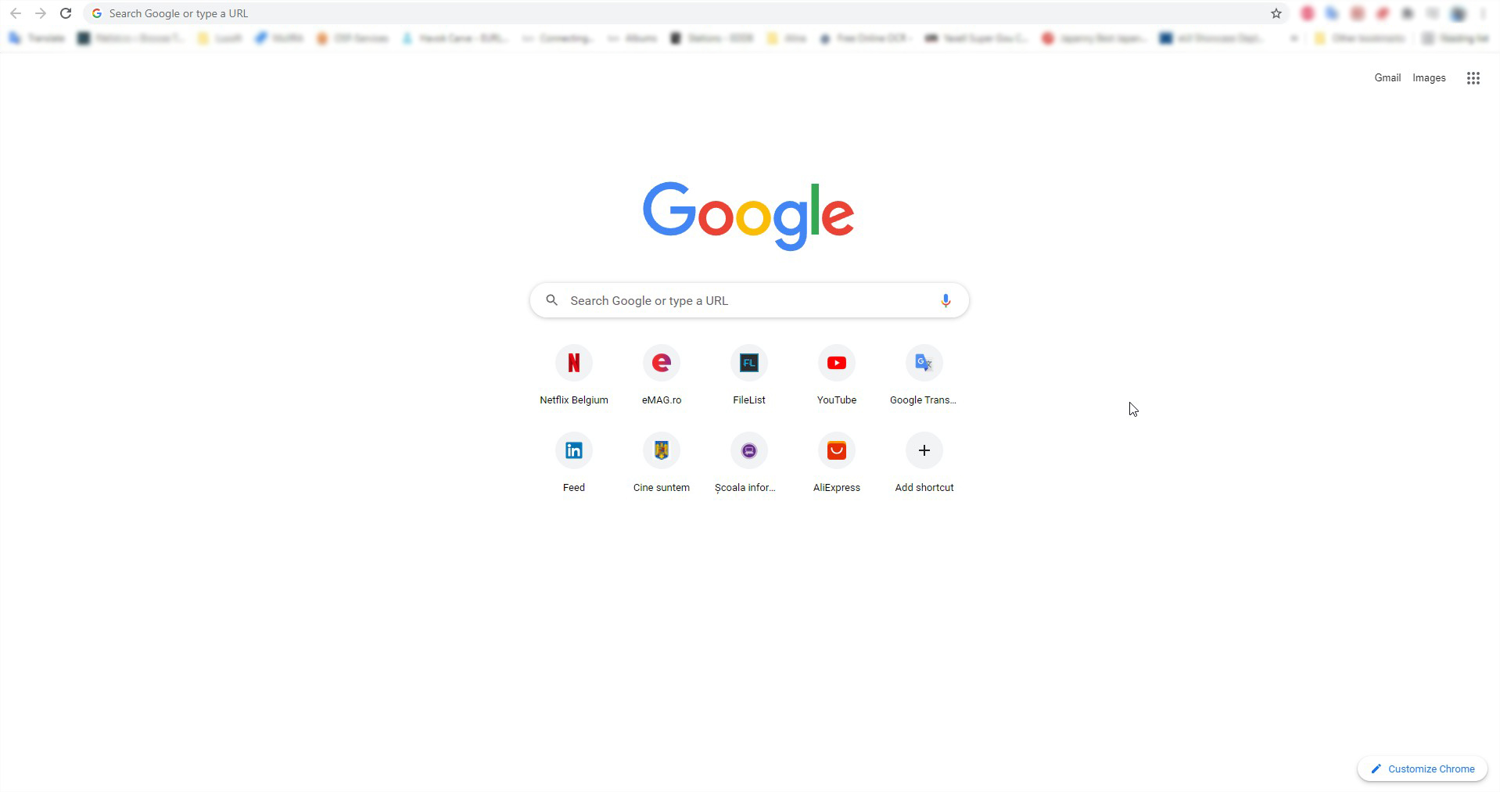



Navigating to Web pages
USER
Browser application
Website address
Rendered website
www.google.com

Slide 2
Requesting Information
Browser
Address request (GET)
Translates domain to IP
Request for HTML code from server
HTML source code from server that will be rendered in a webpage
address
IP address
IP address
Source code
DNS server
website server

Slide 3
Understanding request
The three-way handshake
Method used in a TCP/IP network to create a connection between a local host/client and server. It is a three-step method that requires both the client and server to exchange SYN and ACK (acknowledgment) packets before actual data communication begins.
Host A sends packet
Host B receives A’s SYN packet
Host A
Host B
TCP SYNchronize packet
Host A receives B’s SYN - ACK packet
Host B sends SYN - ACK packet
Host A
Host B
SYNchronize ACKnowledgement
Host A sends ACK packet
Host B receives A’s ACK packet
Host A
Host B
ACKnowledgement
TCP socket connection is ESTABLISHED

Slide 4
Understanding Web pages
Browser application
Rendered source code
HTML
CSS
JavaScript
Structure of the code
Styling of the elements that create the page
Deals with behavior and all the interactive elements of the page

Slide 5
Understanding Framework
Website
Server
Code that runs on the server side that interprets our requests and interactions with the browser
JavaScript
Node.js, PHP, Python, …
Frameworks
Frameworks
Express, Laravel, Django….
Angular, React, Vue….
Packages of utilities functions that make the writing of code easier

